Slide 1
UML(Unified Modeling Language)
NEUROFORGE ENTERPRISE SDLC PLATFORM
Presented By :
Praveen Kumar Ramesh
JULY 28, 2026

Slide 2
What is UML?
Unified Modeling Language (UML) is a standardized visual modeling language used in software engineering to plan, design, visualize, document, and communicate the architecture and functionality of a software system before coding begins. Rather than describing a system only with text, UML uses diagrams and graphical symbols to represent different aspects of the software, making it easier for developers, designers, testers, and stakeholders to understand how the system works.
UML acts as a blueprint for software development, similar to how architects create building plans before construction. It helps development teams analyze requirements, define system structure, model user interactions, and design workflows before implementation. This reduces ambiguity, improves communication, and ensures that everyone involved in the project has a clear understanding of the system.
UML is independent of programming languages, meaning it can be used to design software systems regardless of whether they are implemented in Java, Python, C#, or any other language. It is widely used in object-oriented software development and supports all phases of the Software Development Life Cycle (SDLC), from requirement analysis to maintenance.

Slide 3
Why is UML Used ?
  Provides a visual blueprint of the software system.
  Improves communication between developers, testers, project managers, and stakeholders.
  Helps identify design issues before coding starts, reducing development time and cost.
  Documents the system for future maintenance and upgrades.
  Simplifies complex software systems by breaking them into understandable diagrams.
  Supports object-oriented analysis and design, making development more structured and efficient.
Example
For the NeuroForge Enterprise SDLC Platform, UML diagrams can illustrate:
  Who interacts with the system (Use Case Diagram).
  How a process flows from start to finish (Activity Diagram).
  How different modules communicate over time (Sequence Diagram).
  The structure of the system, including classes and relationships (Class Diagram).
Using UML before development ensures that the project is well-planned, easier to understand, and less prone to design errors, leading to the development of reliable and high-quality software.

Slide 4
Types of UML
UML diagrams are classified into two categories:
1. Structural Diagrams – Represent the static structure of the system.
  Class Diagram
  Object Diagram
  Component Diagram
  Deployment Diagram
  Package Diagram
2. Behavioral Diagrams – Represent the dynamic behavior of the system.
  Use Case Diagram
  Activity Diagram
  Sequence Diagram
  State Machine Diagram
  Communication Diagram

Slide 5
User Case Diagram
What is a Use Case Diagram?
A Use Case Diagram is a behavioral UML diagram that shows how users (actors) interact with a software system. It represents the system's functionalities from the user's perspective without showing implementation details.
Main Components
  Actor: A person or external system interacting with the application.
  Use Case: A function or service provided by the system.
  System Boundary: Defines the scope of the system.
  Association: A line showing interaction between an actor and a use case.
Why is it Used?
  Identifies system requirements.
  Defines user interactions with the system.
  Helps developers understand functional requirements.
  Improves communication with stakeholders.
  Acts as a foundation for system design and testing.

Slide 6
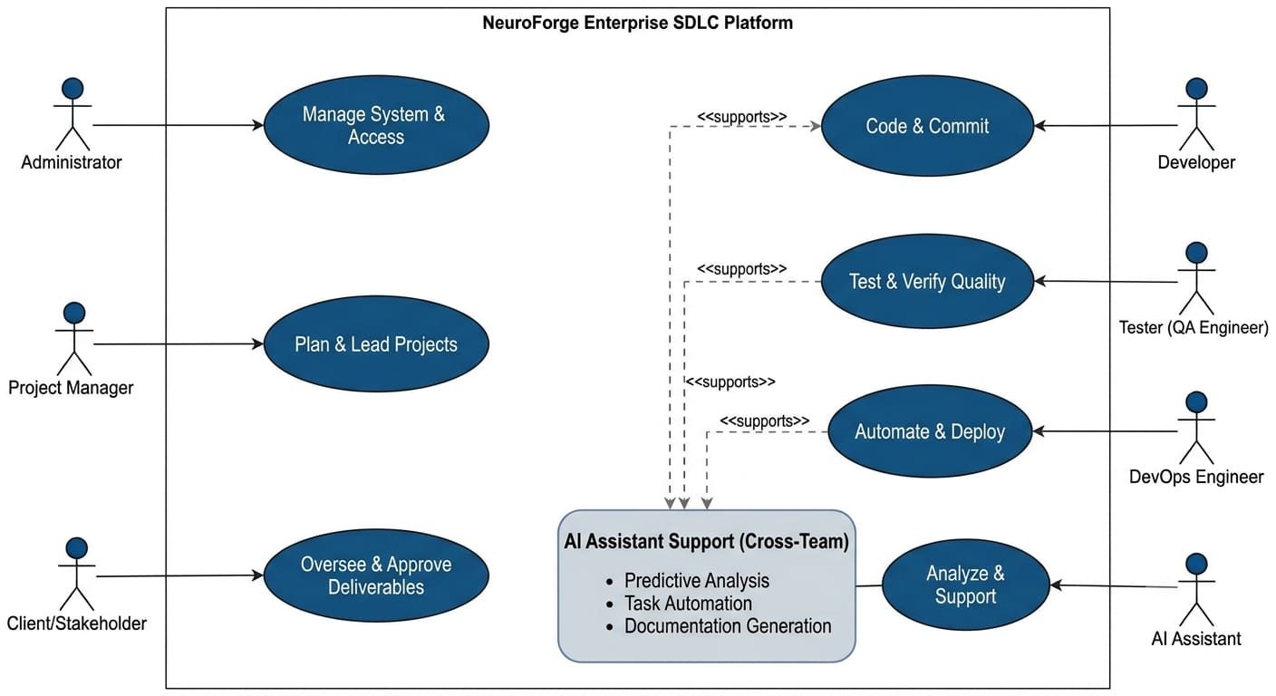
User Case Diagram Example

Slide 7
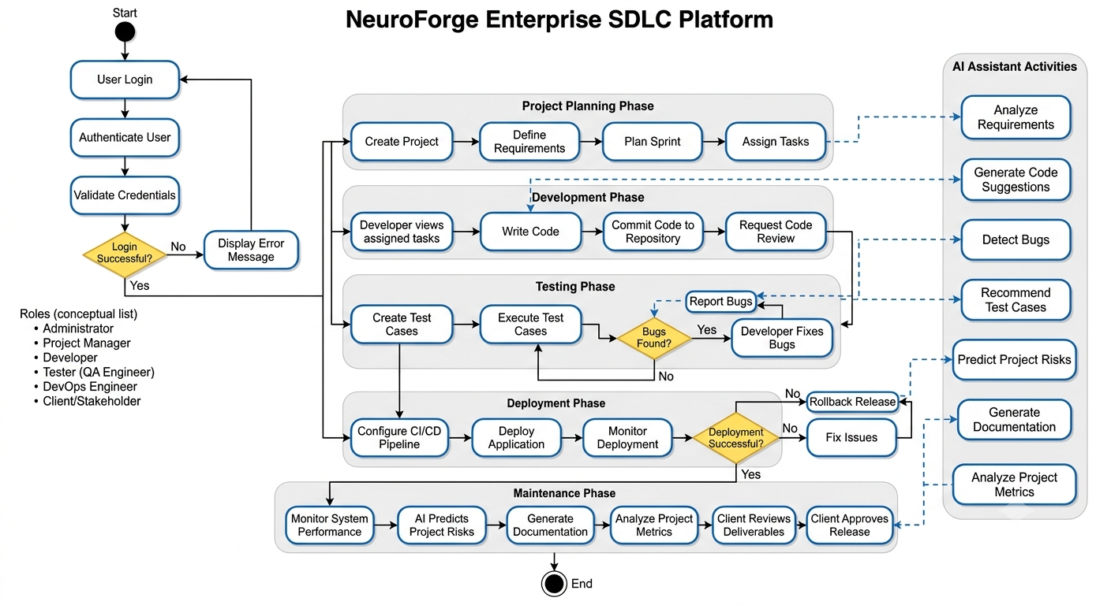
Activity Diagram Example

Slide 8
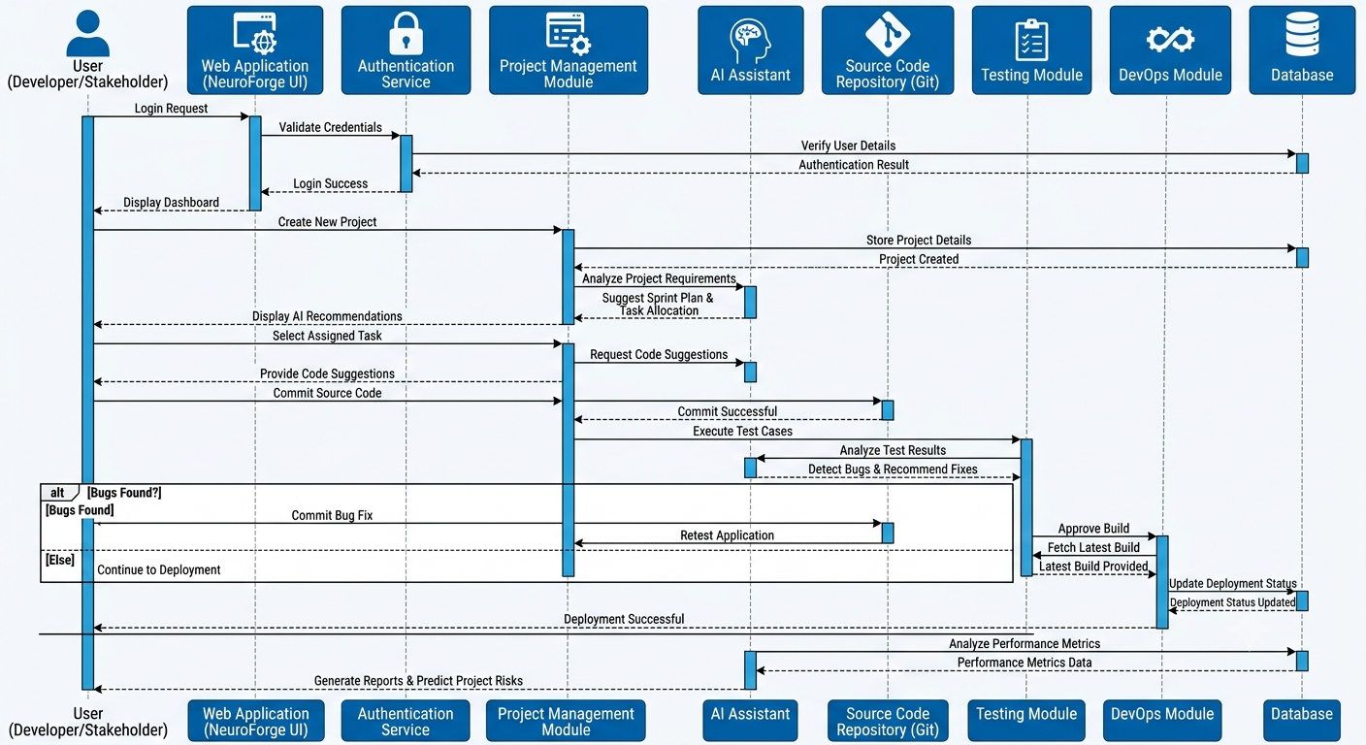
Sequence Diagram Example

Slide 9
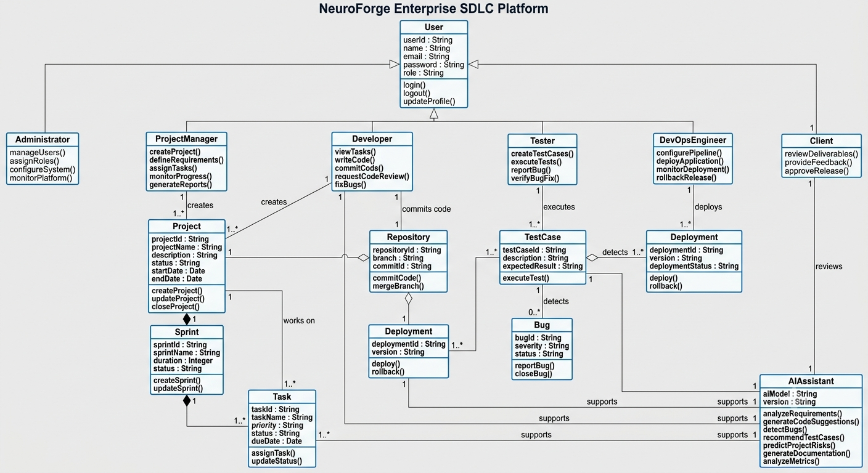
Class Diagram Example

Slide 10
Thank You !
Presented By :
Praveen Kumar Ramesh
JULY 28, 2026

